Slide 1
Component-Based Software Engineering
Main issues:
• assemble systems out of (reusable) components
• compatibility of components
Notes:
© SE;CBSE, Hans van Vliet

Slide 2

LEGO analogy
Set of building blocks in different shapes and colors
Can be combined in different ways
Composition through small stubs in one and corresponding holes in another building block
⇒ LEGO blocks are generic and easily composable
LEGO can be combined with LEGO, not with Meccano
©2008 John Wiley & Sons Ltd.
www.wileyeurope.com/college/van vliet

Slide 3

Why CBSE?
CBSE increases quality, especially evolvability and maintainability
CBSE increases productivity
CBSE shortens development time
©2008 John Wiley & Sons Ltd.
www.wileyeurope.com/college/van vliet

Slide 4

Component model
Defines the types of building block, and the recipe for putting them together
More precisely, a component model defines standards for:
  Properties individual components must satisfy
  Methods and mechanisms for composing components
Consequently, a component has to conform to some component model
©2008 John Wiley & Sons Ltd.
www.wileyeurope.com/college/van vliet

Slide 5

A software component:
Implements some functionality
Has explicit dependencies through provides and required interfaces
Communicates through its interfaces only
Has structure and behavior that conforms to a component model
©2008 John Wiley & Sons Ltd.
www.wileyeurope.com/college/van vliet

Slide 6
A component technology
Is the implementation of a component model, by means of:
  Standards and guidelines for the implementation and execution of software components
  Executable software that supports the implementation, assembly, deployment, execution of components
Examples: EJB, COM+, .NET, CORBA
©2008 John Wiley & Sons Ltd.
www.wileyeurope.com/college/van vliet

Slide 7
Component forms
Component goes through different stages: development, packaging, distribution, deployment, execution
Across these stages, components are represented in different forms:
  During development: UML, e.g.
  When packaging: in a .zip file, e.g.
  In the execution stage: blocks of code and data
©2008 John Wiley & Sons Ltd.
www.wileyeurope.com/college/van vliet

Slide 8
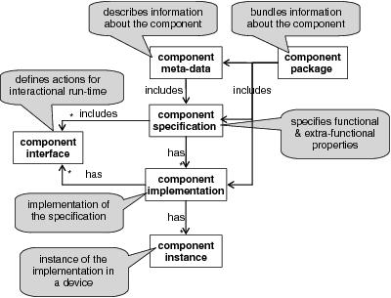
Characterization of component forms
©2008 John Wiley & Sons Ltd.
www.wileyeurope.com/college/van vliet

Slide 9
Component specification vs component interface
Interface describes how components interact: usage contract
Specification is about the component as a whole, while an interface might be about part of a component only
©2008 John Wiley & Sons Ltd.
www.wileyeurope.com/college/van vliet

Slide 10
Hiding of component internals
Black box: only specification is known
Glass box: internals may be inspected, but not changed
Grey box: part of the internals may be inspected, limited modification is allowed
While box: component is open to inspection and modification
©2008 John Wiley & Sons Ltd.
www.wileyeurope.com/college/van vliet

Slide 11
Managing quality in CBSE
Who manages the quality: the component, or the execution platform
Scope of management: per-collaboration, or system-wide
©2008 John Wiley & Sons Ltd.
www.wileyeurope.com/college/van vliet

Slide 12
Common features of component models
Infrastructure mechanisms, for binding, execution, etc
Instantiation
Binding (design time, compile time, …)
Mechanisms for communication between components
Discovery of components
Announcement of component capabilities (interfaces)
Development support
Language independence
Platform independence
Analysis support
Support for upgrading and extension
Support for quality properties
©2008 John Wiley & Sons Ltd.
www.wileyeurope.com/college/van vliet

Slide 13
Development process in CBSE
Two separate development processes:
  Development of components
  Development of systems out of components
Separate process to assess components
©2008 John Wiley & Sons Ltd.
www.wileyeurope.com/college/van vliet

Slide 14
CBSE system development process
Requirements: also considers availability of components (like in COTS)
Analysis and design: very similar to what we normally do
Implementation: less coding, focus on selection of components, provision of glue code
Integration: largely automated
Testing: verification of components is necessary
Release: as in classical approaches
Maintenance: replace components
©2008 John Wiley & Sons Ltd.
www.wileyeurope.com/college/van vliet

Slide 15

Component assessment
Find components
Verify components
Store components in repository
©2008 John Wiley & Sons Ltd.
www.wileyeurope.com/college/van vliet

Slide 16
Component development process
Components are intended for reuse
⇒
Managing requirements is more difficult
More effort required to develop reusable components
More effort in documentation for consumers
©2008 John Wiley & Sons Ltd.
www.wileyeurope.com/college/van vliet

Slide 17
Component development process
Requirements: combination of top-down (from system) and bottom-up (generality)
Analysis and design: generality is an issue, assumptions about system (use) must be made
Implementation: largely determined by component technology
Testing: extensive (no assumptions of usage!), and well-documented
Release: not only executables, also metadata
©2008 John Wiley & Sons Ltd.
www.wileyeurope.com/college/van vliet

Slide 18
Component maintenance
Who is responsible: producer or consumer?
Blame analysis: relation between manifestation of a fault and its cause, e.g.
  Component A requires more CPU time
  As a consequence, B does not complete in time
  As required by C, so
  C issues a time-out error to its user
  Analysis: goes from C to B to A to input of A
  Who does the analysis, if producers of A,B,C are different?
©2008 John Wiley & Sons Ltd.
www.wileyeurope.com/college/van vliet

Slide 19
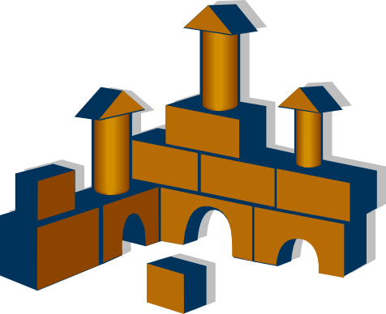
Architecture and CBSE
Architecture-driven: top-down: components are identified as part of an architectural design
Product line: family of similar products, with 1 architecture
COTS-based: bottom-up, architecture is secondary to components found
©2008 John Wiley & Sons Ltd.
www.wileyeurope.com/college/van vliet

Slide 20
Summary
To enable composition, components must be compatible: achieved by component model
Separation of development process for components from that of assembling systems out of components
Architectural plan organizes how components fit together and meet quality requirements
©2008 John Wiley & Sons Ltd.
www.wileyeurope.com/college/van vliet

